Slide 1
X Education Lead Scoring CASE STUDIES
BY
SHANKAR CHAUDHARY
Deepak Rajan
Md Ahmad

Slide 2
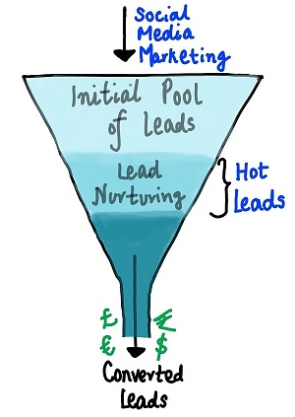
Problem Statement
Introduction
An education company named X Education sells online courses to industry professionals. On any given day, many professionals who are interested in the courses land on their website and browse for courses.
The company markets its courses on several websites and search engines like Google. Once these people land on the website, they might browse the courses or fill up a form for the course or watch some videos. When these people fill up a form providing their email address or phone number, they are classified to be a lead. Moreover, the company also gets leads through past referrals. Once these leads are acquired, employees from the sales team start making calls, writing emails, etc. Through this process, some of the leads get converted while most do not. The typical lead conversion rate at X education is around 30%.
Now, although X Education gets a lot of leads, its lead conversion rate is very poor. For example, if, say, they acquire 100 leads in a day, only about 30 of them are converted. To make this process more efficient, the company wishes to identify the most potential leads, also known as ‘Hot Leads’. If they successfully identify this set of leads, the lead conversion rate should go up as the sales team will now be focusing more on communicating with the potential leads rather than making calls to everyone. A typical lead conversion process can be represented using the following funnel:
As you can see, there are a lot of leads generated in the initial stage (top) but only a few of them come out as paying customers from the bottom. In the middle stage, you need to nurture the potential leads well (i.e. educating the leads about the product, constantly communicating etc. ) in order to get a higher lead conversion.
X Education has appointed you to help them select the most promising leads, i.e. the leads that are most likely to convert into paying customers. The company requires you to build a model wherein you need to assign a lead score to each of the leads such that the customers with a higher lead score have a higher conversion chance and the customers with a lower lead score have a lower conversion chance. The CEO, in particular, has given a ballpark of the target lead conversion rate to be around 80%.

Slide 3
Business Objectives
There are quite a few goals for this case study:
Build a logistic regression model to assign a lead score between 0 and 100 to each of the leads which can be used by the company to target potential leads. A higher score would mean that the lead is hot, i.e. is most likely to convert whereas a lower score would mean that the lead is cold and will mostly not get converted.
There are some more problems presented by the company which your model should be able to adjust to if the company's requirement changes in the future so you will need to handle these as well. These problems are provided in a separate doc file. Please fill it based on the logistic regression model you got in the first step. Also, make sure you include this in your final PPT where you'll make recommendations.

Slide 4
Data Understanding
You have been provided with a leads dataset from the past with around 9000 data points. This dataset consists of various attributes such as Lead Source, Total Time Spent on Website, Total Visits, Last Activity, etc. which may or may not be useful in ultimately deciding whether a lead will be converted or not. The target variable, in this case, is the column ‘Converted’ which tells whether a past lead was converted or not wherein 1 means it was converted and 0 means it wasn’t converted. You can learn more about the dataset from the data dictionary provided in the zip folder at the end of the page. Another thing that you also need to check out are the levels present in the categorical variables. Many of the categorical variables have a level called 'Select' which needs to be handled because it is as good as a null value (think why?).
1. Leads.csv
It contains all the information about leads sources, Total Time Spent on Website, Total Visits, Last Activity, etc. which may or may not be useful in ultimately deciding whether a lead will be converted or not.
2. Leads Data Dictionary.xlsx
It contains the variables and their descriptions.

Slide 5
Lead scoring case study solution

Slide 6
Background
X Education is a company that sells online courses to industry professionals. They market their courses on different websites like Google, and when people are interested, they come to the X Education website. These people might look at the courses, fill out a form for a course, or watch some videos before deciding whether to buy.
The company wants to identify the people who are most likely to buy a course (called "hot leads") and focus on them to increase sales.
When people visit X Education's website, they might fill out a form with their contact information like email or phone number. These people are called "leads." After getting leads, employees from the sales team try to convert these leads into customers by making calls, sending emails etc. However, not all leads convert into customers. Usually, about 30% of leads become customers for X Education.

Slide 7
Problem Statement
X Education gets a lot of leads but not all of them turn into customers. To make the process more efficient, the company wants to identify the best leads (called "Hot Leads") so that the sales team can focus on them. By doing this, the lead conversion rate should increase.
We need to build a model that assigns a lead score to each lead, with higher scores indicating a higher chance of conversion. The CEO wants the lead conversion rate to be 80%.

Slide 8
Objective:
The process of identifying "hot leads" in the context of an education business refers to the identification of potential students who are most likely to convert into paying customers. By focusing more attention and resources on these hot leads, the conversion ratio (the number of leads that convert into paying customers) can be improved.
There are several ways to identify hot leads in an education business. One common method is to use data from previous customer interactions to identify patterns and characteristics that are associated with successful conversions. For example, if a significant number of paying customers have previously shown interest in a specific program or course, leads that express similar interests can be considered hot leads.
Another way to identify hot leads is to use lead scoring methods. Lead scoring is the process of assigning a numerical value to each lead based on their level of engagement and interest. Leads with high scores are considered hot leads and are given priority in the sales process.
In addition to these methods, it is also important to conduct thorough research on the target market and understand their needs and pain points. Identifying key demographics and psychographics of your ideal customer will also help in identifying hot leads.
Overall, identifying hot leads is a crucial step in improving the conversion ratio for an education business. By focusing more attention and resources on these leads, the chances of converting them into paying customers are greatly increased.

Slide 9
Lead – Conversion Process
Lead Generation:
Ads on websites like Google, other websites etc.
Referrals
Visit to X Education website by these potential customers (professionals)
Visitors either provide Email id & Contact Details
Or
View videos etc.
Tele calling and Emailing activity to all the leads
~30% leads get converted
To build a model to filter leads and identify the most promising ones, known as "Hot Leads" with the target lead conversion rate of 80% or higher by assigning a lead score to each lead.

Slide 10
Proposed Solution
Hot lead selection
Communicating with Hot Leads
Conversion of Hot Leads
Focus Communication
Smaller set of leads
More impactful communication
Improve conversion rate
Focus on communicating effectively with a smaller set of leads to increase the impact and improve the conversion rate.
By identifying and focusing on the most promising leads, also known as "Hot Leads," we increase the chances of conversion. By narrowing down our focus to this smaller, high-potential group, we can improve our communication efforts and increase our conversion rate, ultimately helping us to achieve our target conversion rate of 80%.
This approach allows us to be more efficient and effective in our sales efforts, resulting in a more successful outcome for the company.
Hot lead selection is the process of identifying the most promising leads for conversion by using data, lead scoring, market research, and ideal customer demographics. This increases conversion chances.
Clustering leads into categories based on conversion tendency
Identify a smaller section of hot leads.
Focus more on this section for better conversion chances.

Slide 11
Implementation

Slide 12
Loading & Observing the past data provided by the Company
Univariate, Bivariate, and Heatmap for numerical and categorical columns
Performing pre-requisites for RFE and Logistic Regression
Data Gathering
Data Cleaning
Performing EDA
Data Preparation
Model Building
Duplicate removal, null value treatment, unnecessary column elimination, etc.
Outlier Treatment, Feature-Standardization

Slide 13
Selection of top 25 features using RFE
Reduction of columns and Model re-building
Verifying our Final Model Accuracy etc. with model built with PCA
Feature Selection
Model Building
Model Improvement
Final Model
Verifying with PCA
Model building using RFE for selected columns
Final Model Analysis and performance on Test Data

Slide 14
1. Importing all the necessary required libraries
Below are necessary libraries required to import for analysis
import numpy as np # importing numpy as np
import pandas as pd # importing pandas as pd
import matplotlib.pyplot as plt # It is a collection of functions that make matplotlib work like MATLAB
import seaborn as sns # Seaborn is a Python data visualization library based on matplotlib
%matplotlib inline
import warnings # Warnings are categorized using subclasses of the built-in exception class Warning
warnings.filterwarnings("ignore") # It tells the interpreter to ignore any warnings that are generated during the execution of the code
from sklearn.preprocessing import StandardScaler # It is a class in the scikit-learn library that is used to standardize features by removing the mean and scaling to unit variance

Slide 15
2. Loading or Reading the Dataset
data=pd.read_csv("/Users/shan/Documents/SHAN/Lead Scoring Case Study/Leads.csv")

Slide 16
2. Data inspection, routine check and preparation
Identifying and removing the unwanted variables
Identified the values to replace missing values
Replacing of

Slide 17
Data inspection and removing the unwanted variables
Inspected the data by using head, tail, shape, info() & Describe built-in function.
Identify the null /missing value by using null() function
Check the null value 45% & higher in the column
Further drop the column those are having 45% and higher missing value by using drop() function
Lead Quality 51.59%, Asymmetrique Activity Index 45.64%, Asymmetrique Profile Index 45.64%, Asymmetrique Activity Score 45.64% Asymmetrique Profile Score 45.64%.
As few column with percentage of null values are above 0 and less than and equal to 40% and the columns which have percentage of null values between 0-1 are very small so these columns will either drop them or impute them with mode value respectively.
Checked the NaN value present in rows and found that there is no more than 50% that has considered for further check and analysis
Now the veriable doesn’t has null value hence considering for further analysis.

Slide 18
Identification of null values to replace missing values
Check the missing value and either drop if not necessary of if necessary then impute it
Checked the 45% and higher null values available in the columns that I have dropped
Lead Quality 51.59%,
Asymmetrique Activity Index 45.64%,
Asymmetrique Profile Index 45.64%,
Asymmetrique Activity Score 45.64%
Asymmetrique Profile Score 45.64%

Slide 19
Plots (Visualization)

Slide 20
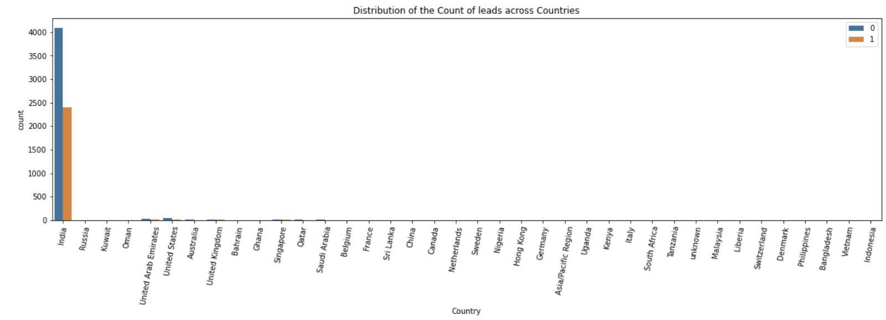
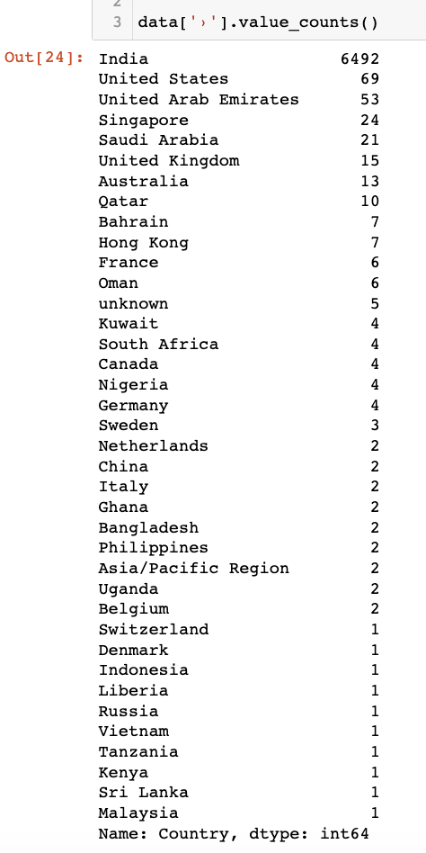
Categorical variables
Country
We can see by using Countplot visualization that Distribution of the Count of leads across Countries where the most of lead are belongs from India.
Since "India" is tagged as the most occurring Country, it may not be suitable for an analysis - especially for a classification problem. Hence we can remove the Country column in order to escape from the bias

Slide 21
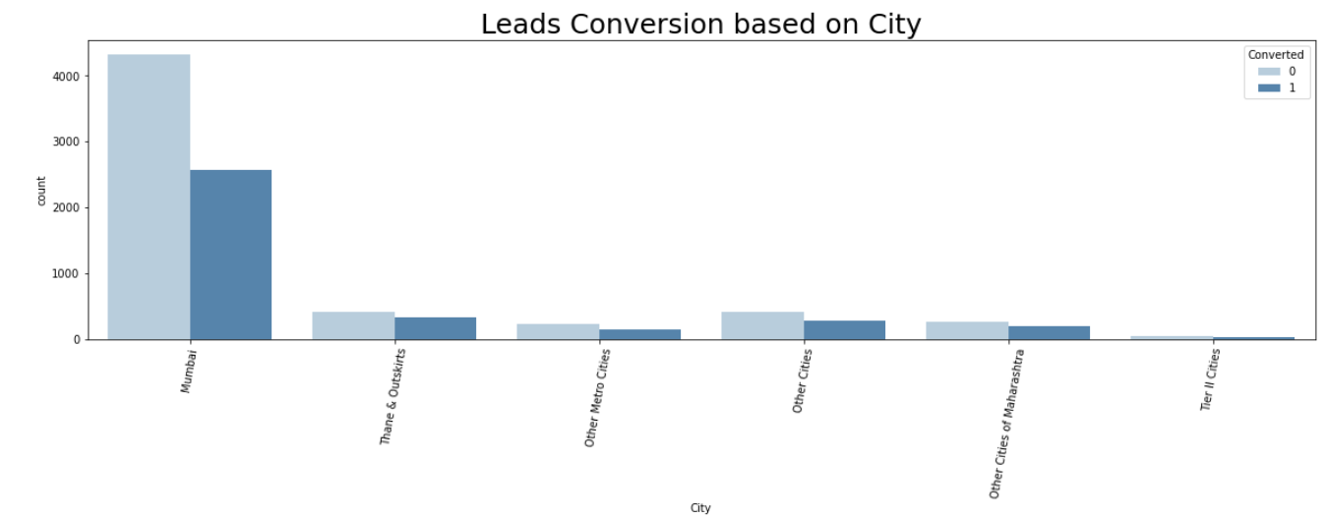
City
The lead conversion based on city wherein we can see that Mumbai is the most occurring city In the data.
Mumbai has been tagged as the most frequently occurring value. hence we can impute Null values with Mumbai.

Slide 22
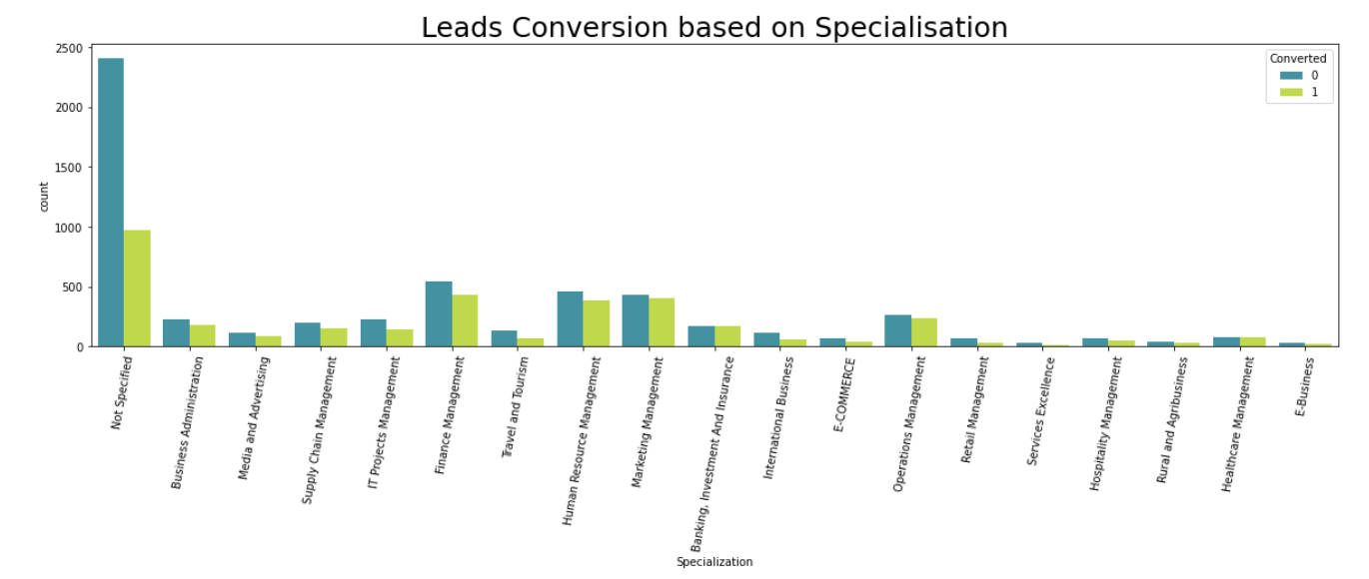
Specialization
Management has the higher number of leads converted. This is important and should not be removed.
Since Management is an import metric inside Specialization, we could combine the entire Managements under one umbrella
We will call this combo as Management_Specializations refer next page.

Slide 23
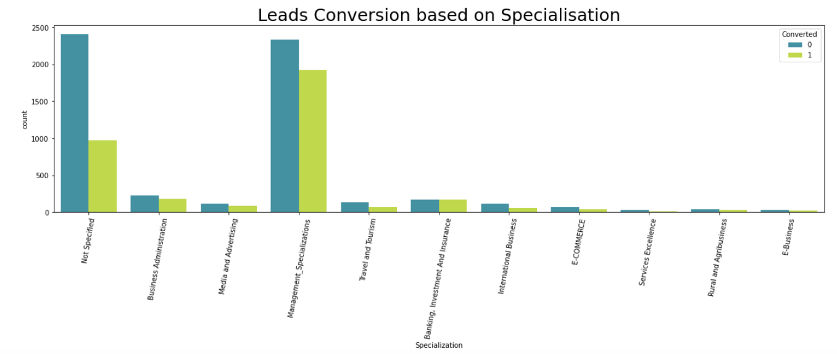
Management_Specializations

Slide 24
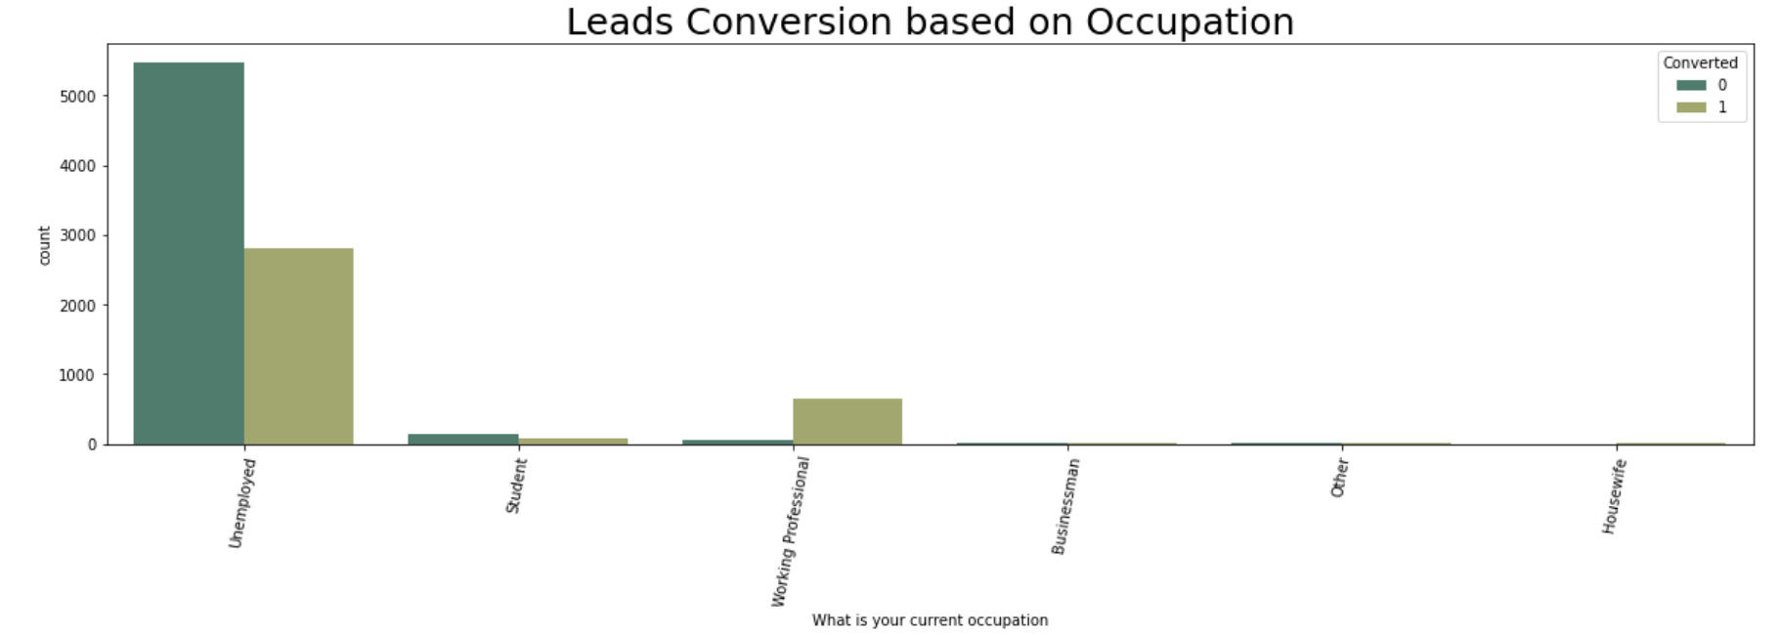
Employment
Chances are high for the Working Professionals who would be going for the courses.
Unemployed leads are the most in this leads
Housewives, Businessman, Student and Other categories may not be converted to join the courses.

Slide 25
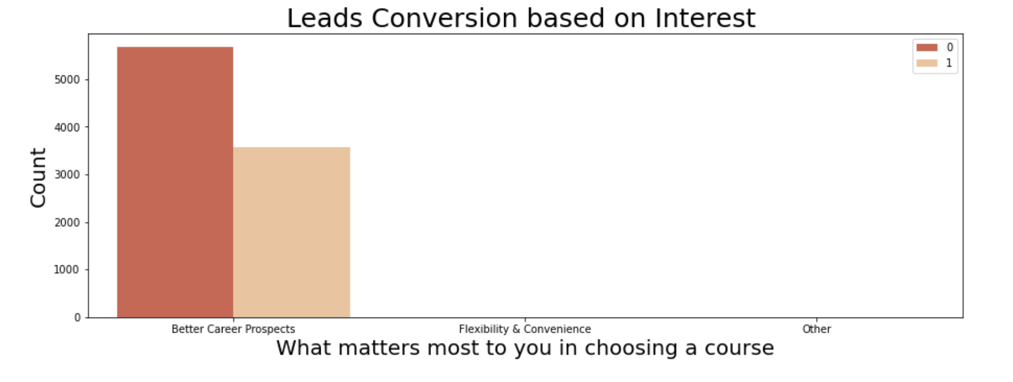
Leads Conversion based on Interest
We can see that better career prospect is the most lead.
Since "Better Career Prospects" influences the column drastically, we can remove that column as it will create bias.

Slide 26
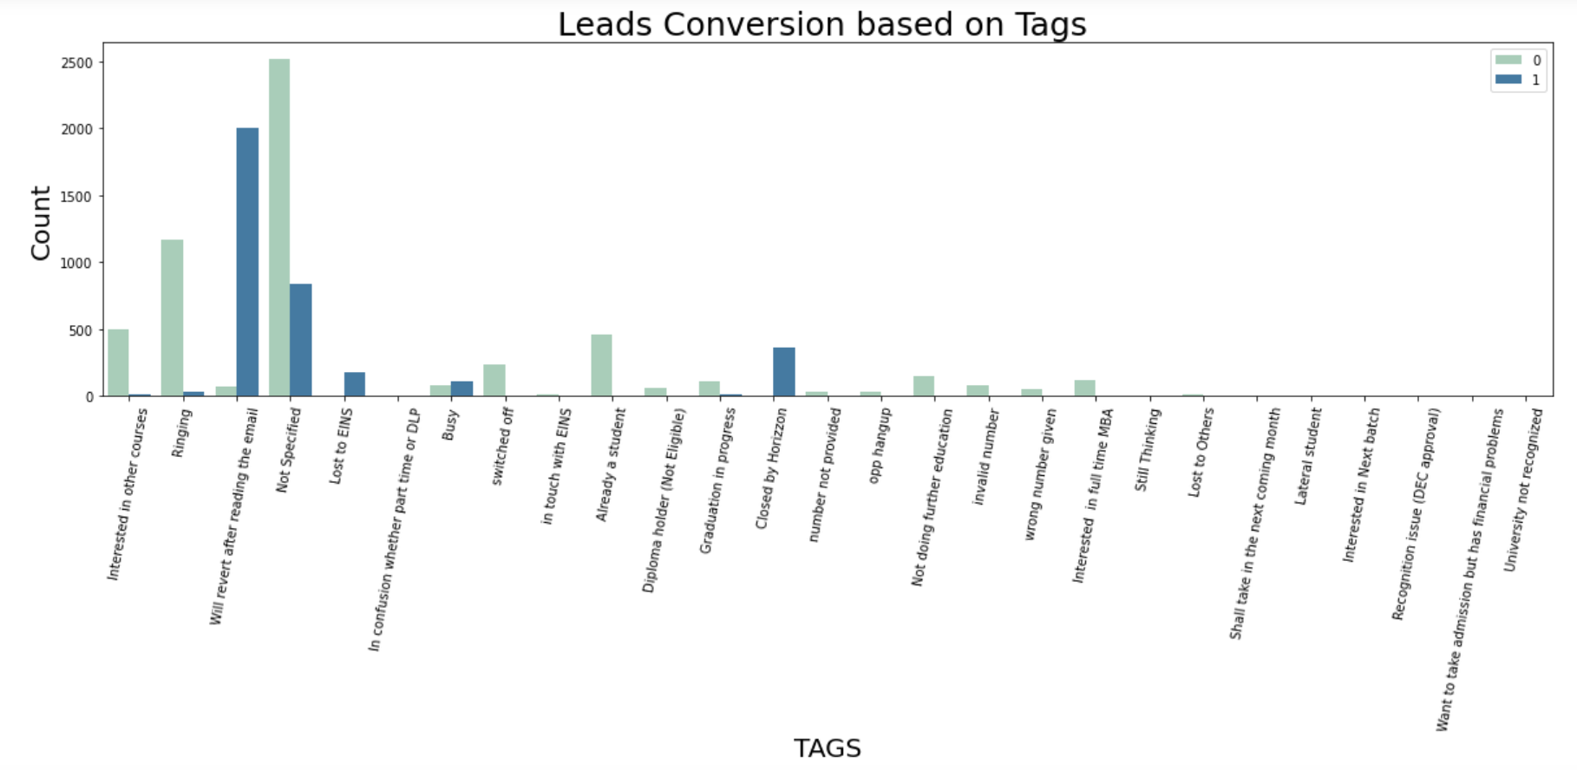
Leads Conversion based on Tags
The most of lead are converted based on Tag

Slide 27
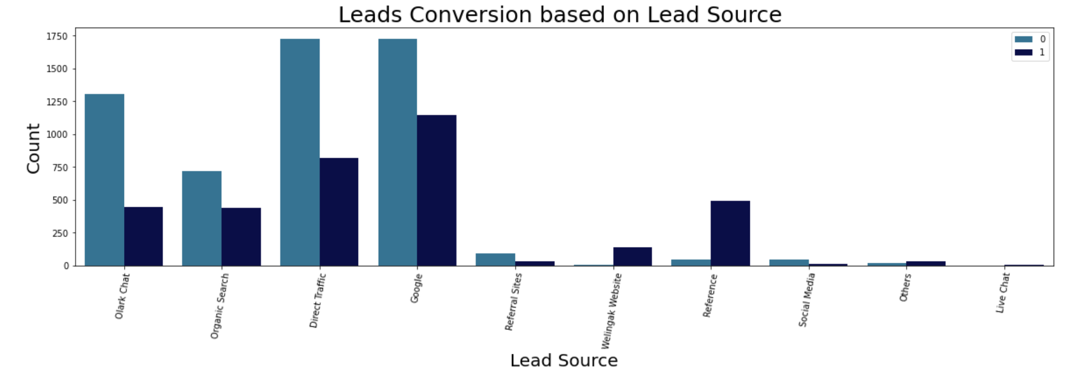
Leads Conversion based on Lead Source
Most of the leads generated are through the "Google" & "Direct traffic" and the least through the "Live Chat" "Welingak website" has the most conversion rate Lead conversion can be improved by maximising leads from "Reference" and "Welingak website" Focussing "Olark chat","Organic search","Direct Traffic", and "Google" leads may increase the lead conversion.

Slide 28
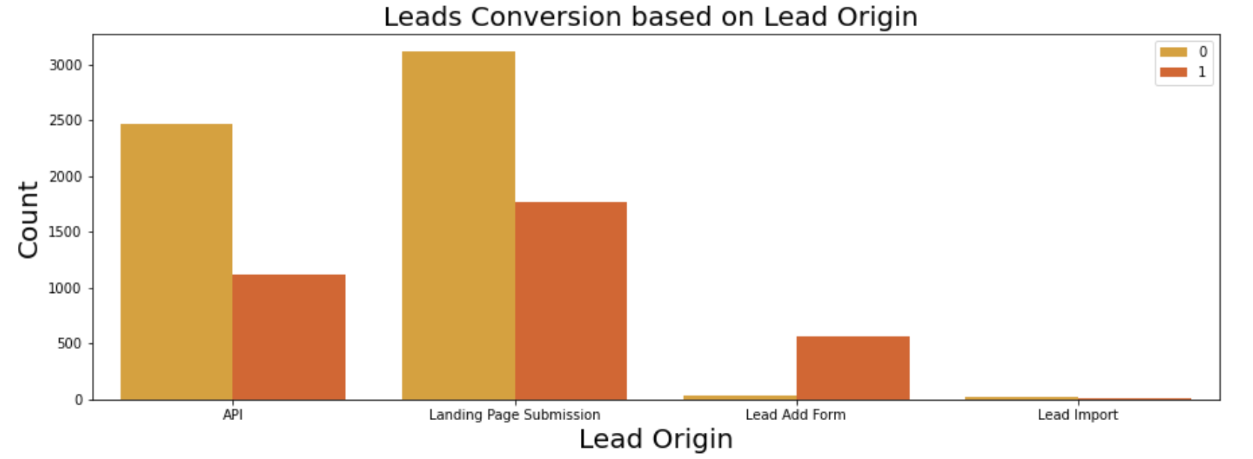
Leads Conversion based on Lead Origin
API and Landing Page Submission bring more number of leads as well as conversion.
Lead Add Form has a very high conversion rate but count of leads are not very high.
If Lead add form could get more leads, then the rate of conversion can be very high and for overall growth

Slide 29
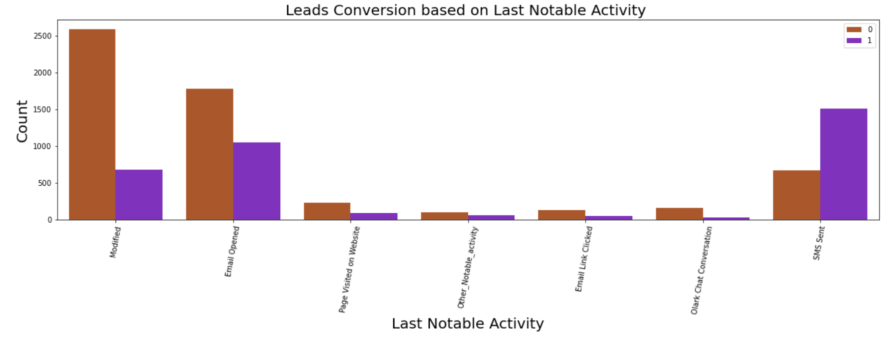
Leads Conversion based on Last Notable Activity
SMS Sent has more conversion than any of the activity Seems Modified has the least conversion ratio Also, Other Notable activity also has almost very signifiable reason for conversion

Slide 30
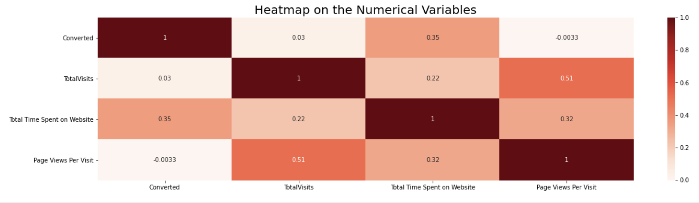
Heatmap
EDA plots depicting correlation (Heat Map) of all selected numerical columns.

Slide 31
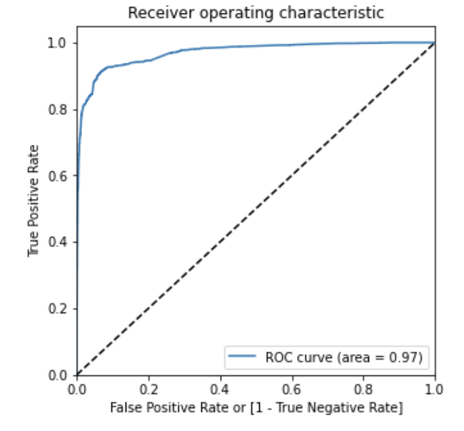
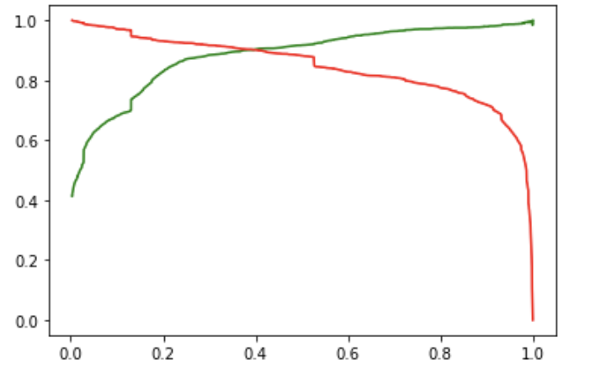
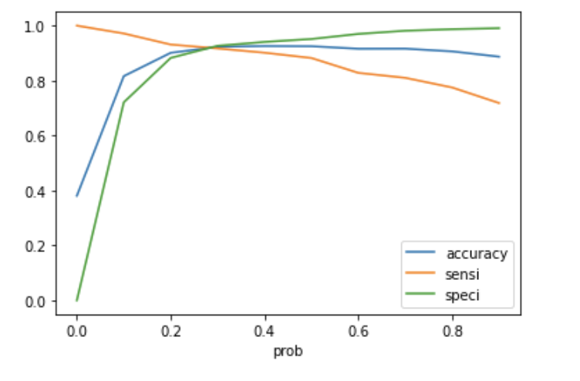
Linear Regression Final Model Parameters
Area under ROC = 0.97
Intermediate cut-off = 0.3
Final cut-off = 0.4

Slide 32
Inference / Conclusion

Slide 33
Model Analysis on Training set
The model performed well with the training data, with
accuracy of 92.29%
sensitivity of 91.7%
&
specificity of 92.66%

Slide 34
Model Analysis on Test set
The model performed also well with the test data, with
accuracy of 92.78%
sensitivity of 91.98%
&
specificity of 93.26%

Slide 35
Inferences from Model
The Business Insights Derived from Model
The are are top three variables that have the greatest impact on lead conversion in the model are:
The total time spend on the Website.
Last Activity_SMS Sent
Tags_Will revert after reading the email
Top 3 variables in my model, that should be focused are:
Olark chat
Organic search
Direct Traffic and
Google

Slide 36
Conclusion
The fact that most of the responses we received are from India and Mumbai in particular is noteworthy. It may be worth exploring other markets to potentially gain more customers.
Most of the leads generated are from Mumbai, India, and targeting this market could potentially bring in more customers.
Offering discounts and targeting working professionals may increase sales.
Focusing on lead generation through Google and Direct traffic, as well as maximizing leads from reference sites and the Welingak website, may improve lead conversion.
There is a high correlation between two variables "Last Notable Activity_SMS Sent" and "Last Activity_SMS Sent"
The median of time spent on website is 244 mins
Lead generation through API and Landing Page Submission have a higher number of leads and conversion rate
Lead Add Form has a high conversion rate but the number of leads generated is less
To improve overall growth, more leads should be generated through Lead Add Form
Lead conversion can be improved by maximising leads from "Reference" and "Welingak website" Focussing "Olark chat","Organic search","Direct Traffic", and "Google" leads may increase the lead conversion.

Slide 37
Recommendation
Based on the model's high level of accuracy in predicting the conversion rate, it can be used to inform business decisions and provide confidence to the CEO in making sound decisions. However, it's important to keep in mind that the model's predictions are dependent on the quality of the data used to train it, and that other factors may also be at play.
Regularly monitoring the model's performance and making adjustments as necessary is recommended.

